Slide 1
Relation Extraction
2017年5月4日 杨绍雄

Slide 2
01
Previous work
Neural Relation Extraction with Selective Attention over Instances
目录
02
ACL2016
CONTENT
03
Our work in this month

Slide 3
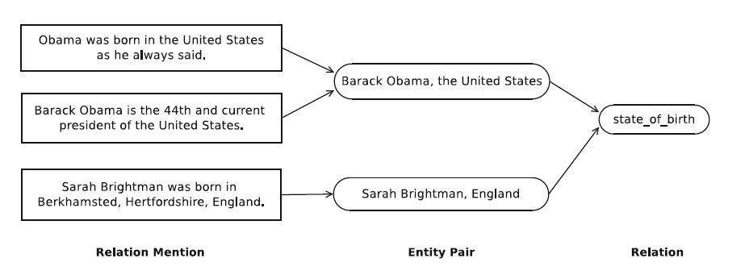
PART 1
之前的工作
将要涉及的概念
· Relation Mention, Entity pair, Relation, Relation extraction
Training dataset?
· Distant supervision
Distant supervision(DS) is one of the most promising methods in information
extraction(IE) to extend traditional supervised methods to web-scale dataset.
The intuition in RE.
Wrong labelling problem.
Page3/17
Notes:
Given a knowledge base D and a corpus L, the intuition
assumes that for any entity pair (e1, e2) belonging to the relation r in D,
all relation mentions of (e1, e2) express the same relation r.

Slide 4
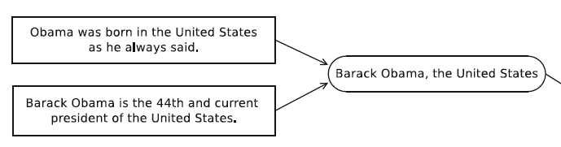
PART 1
之前的工作
Two challenges
1.Not all relation mentions express the same relation as their entity pairs, which
is called the challenge of false positive.
state_of_birth
employed_by
Riedel et al. reported that there are over 31% of false positives in the NYT corpus when
they implied the intuition with Freebase
Page4/17

Slide 5
PART 1
之前的工作
Two challenges
There are massive relation mentions explicitly expressing one of known relations, but their entity pairs are not in the knowledge base.
For example, Min et al. showed that 93.8% of persons from Freebase have no state of birth. These relation mentions will be generated as false negatives via the intuition of DS.
Page5/17

Slide 6
PART 1
之前的工作
Related work
MIL
MIML
Page6/17
Notes:
at-least-one of the relation mentions in each bag express the relation assigned via the intuition of distant supervision. MultiR [9] and Multi-Instance Multi-label(MIML) learning [10] further support multiple relations expressed by different sentences in a bag.

Slide 7
PART 1
之前的工作
Intuition improvement
Reduce the wrong labels introduced by the generation of training data.
We assume that relation mentions expressing the same relation are more similar than those expressing different relations.
1. Divide relation mentions into bags according to the similarity between relation mentions.
2. Align the whole bag to the relation that holds most of the entity pairs of the bag in the knowledge base.
It is now capable for relation mentions with different entity pairs to be divided to the same bag that is likely to express the same relation.
Additionally, relation mentions whose entity pairs never appear in the knowledge base are now possible to be aligned to a known relation, rather than directly labeled with no relation.
Page7/17
Notes:
1之后：From the perspective of relation mentions, we observe that relation mentions of the same entity pair may express different relations.
At the same time, those expressing the same relation may not share the same entity pair.
Obviously, the relation mentions expressing the same relation are similar to each other in the semantic level.

Slide 8
PART 1
之前的工作
Division Generation & Relation Assignment
In our method, we first extract feature vectors from relation mentions by leveraging the feature set developed by Surdeanu et al. , which is the finest handcrafted feature set in relation extraction.
Kmeans + Relation assignment
Page8/17

Slide 9
PART 1
之前的工作
Conclusion
3% improvement
on F1 score
Page9/17

Slide 10
PART 2
Neural Attention Model
Neural Relation Extraction with Selective Attention over Instances
All the feature-based methods depend strongly on the quality of the features generated by NLP tools, which will suffer from error propagation problem.
In this paper, we propose a sentence-level attention-based convolutional neural network (CNN) for distant supervised relation extraction.
To address the wrong labelling problem, we build sentence-level attention over multiple instances, which is expected to dynamically reduce the weights of those noisy instances.
Main contributions:
1. Make full use of all informative sentences of each entity pair.
2. Propose selective attention to de-emphasize those noisy instances.
3. Experiments.
Page10/17
Notes:
1之后：Some recent works (Socher et al., 2012; Zeng
et al., 2014; dos Santos et al., 2015) attempt to
use deep neural networks in relation classification
without handcrafted features. These methods
build classifier based on sentence-level annotated
data, which cannot be applied in large-scale
Therefore, (Zeng et al., 2015) incorporates
multi-instance learning with neural network
model, which can build relation extractor
based on distant supervision data. Although the
method achieves significant improvement in relation
extraction, it is still far from satisfactory.

Slide 11
PART 2
Neural Attention Model
Methodology
Given a set of sentences {x1, x2, … , xn} and two corresponding entities, our model measures the probability of each relation r.
Two parts:
Sentence Encoder: Given a sentence x and two target entities, a convolutional neutral network (CNN) is used to construct a distributed representation x of the sentence.
Selective Attention over Instances: When the distributed vector representations of all sentences are learnt, we use sentence-level attention to select the sentences which really express the corresponding relation.
Page11/17

Slide 12
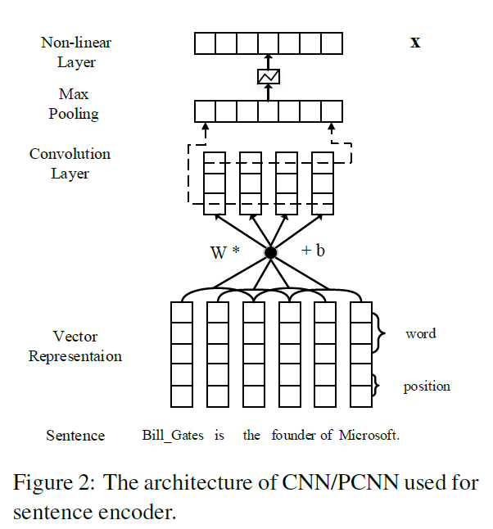
PART 2
Neural Attention Model
Sentence Encoder
Page12/17

Slide 13
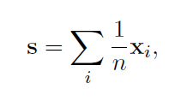
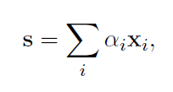
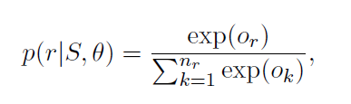
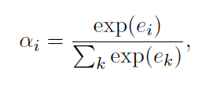


PART 2
Neural Attention Model
Selective Attention over Instances
Suppose there is a set S contains n sentences for entity pair (head; tail), i.e., S = {x1, x2, … , xn}
.
Each sentence representation xi contains information about whether entity pair (head; tail) contains relation r for input sentence xi.
Page13/17

Slide 14
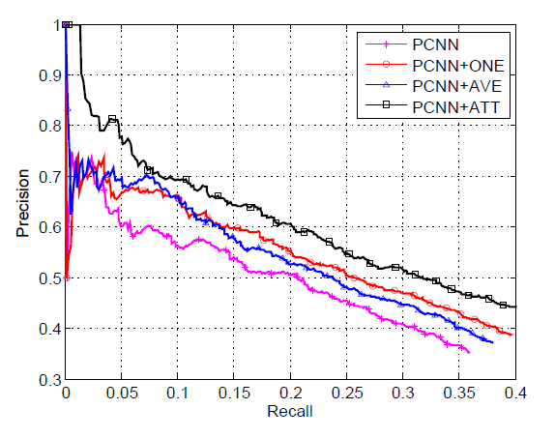
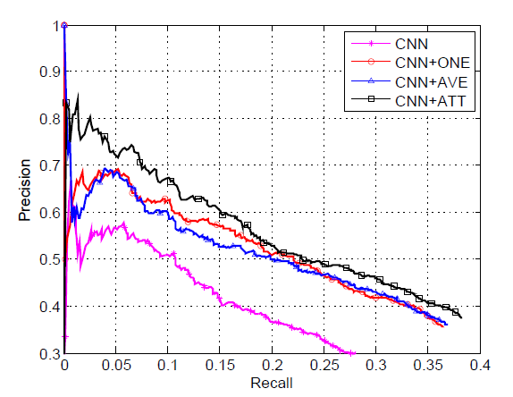
PART 2
Neural Attention Model
Experiments
Dataset: This dataset was generated by aligning Freebase relations with the New York Times corpus (NYT).
Page14/17
Notes:
参数设置 细节
1. For both CNN and PCNN, the ONE method brings better performance as compared to CNN/PCNN. The reason is that the original distant supervision training data contains a lot of noise and the noisy data will damage the performance of relation extraction.
2. For both CNN and PCNN, the AVE method is useful for relation extraction as compared to CNN/PCNN. It indicates that considering more sentences is beneficial to relation extraction since the noise can be reduced by mutual complementation of information.
3. For both CNN and PCNN, the AVE method has a similar performance compared to the ONE method.
4. For both CNN and PCNN, the ATT method achieves the highest precision over the entire range of recall compared to other methods including the AVE method.

Slide 15
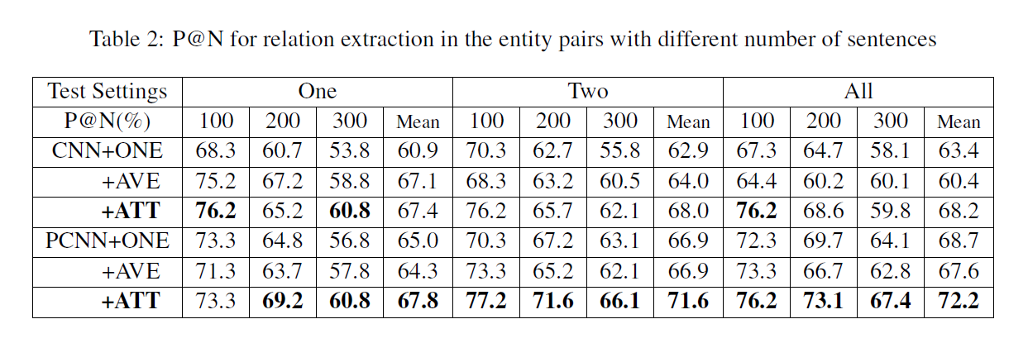
PART 2
Neural Attention Model
Experiments
Page15/17
Notes:
In the original testing data set, there are 74,857 entity pairs that correspond to only one sentence, nearly 3/4 over all entity pairs. Since the superiority of our selective attention lies in the entity pairs containing multiple sentences
1. For both CNN and PCNN, the ATT method achieves the best performance in all test settings. It demonstrates the effectiveness of sentence-level selective attention for multi-instance learning.
2. For both CNN and PCNN, the AVE method is comparable to the ATT method in the One test setting. However, when the number of testing sentences per entity pair grows,
3. For both CNN and PCNN, the ATT method outperforms other two baselines over 5% and 9% in the Two and All test settings.

Slide 16
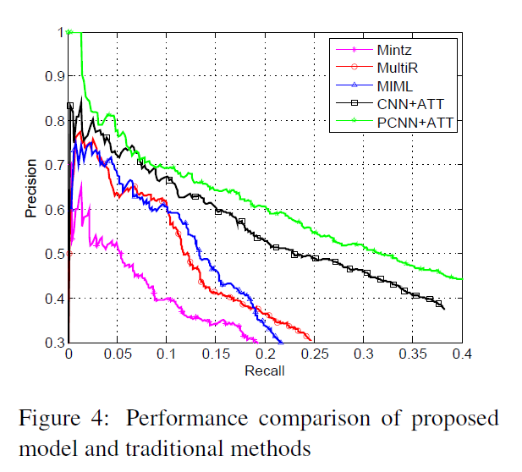
PART 2
Neural Attention Model
Experiments
Page16/17
Notes:
It demonstrates that the human-designed feature cannot concisely express the semantic meaning of the sentences, and the inevitable error brought by NLP tools will hurt the performance of relation extraction.
PCNN+ATT performs much better as compared to CNN+ATT over the entire range of recall.

Slide 17
PART 3
Conclusion and our future work
Page17/17

